Slide 1
Uses of API
API – Application Programing Interface

Slide 2
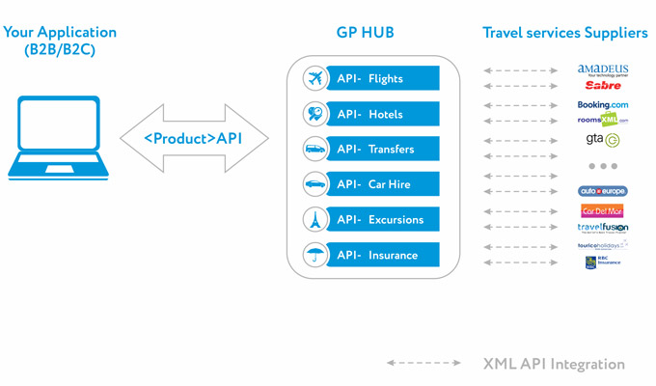
Uses of API
Banks
Airlines
Hotels
Car Hire
Insurance
E-commerce

Slide 3
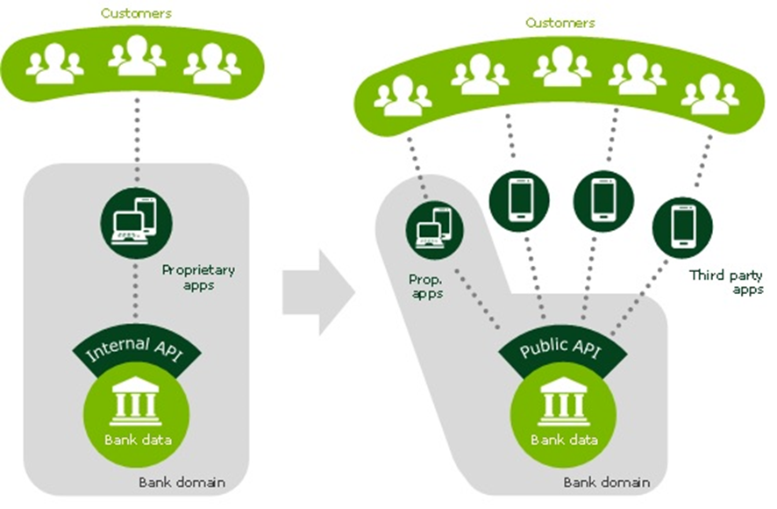
API in banking

Slide 4
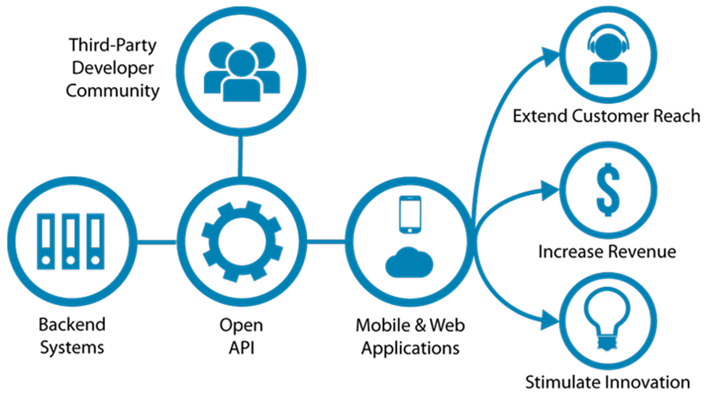

Slide 5
API in banking
1. Banking chatbots: A handful of banks have recently launched chatbots that can converse — to a certain degree of complexity — with customers using natural language.
These AI driven pieces of software have access to the bank databases, account information and can help customers solve many common problems themselves, leaving only the more difficult customer service issues to a real human agent.
Bank of America’s recently launched Erica and Mastercard’s Mastercard KAI. Mastercard’s chatbot will work through Facebook Messenger. The credit card company plans to expand to other platforms later.
2. Location API: It lets customers see branch and ATM locations, including special details such as notary or foreign currency services available or various languages spoken at that location, in real time.

Slide 6
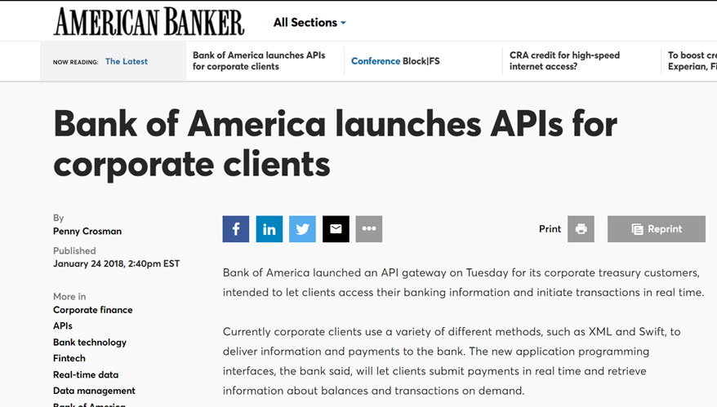

Slide 7
References
http://zanders.eu/en/latest-insights/how-open-banking-will-change-the-banking-landscape/
https://www.bankingtech.com/2018/01/open-banking-what-you-need-to-know/
https://banknxt.com/60731/open-banking-financial-data/
https://www.americanbanker.com/news/bank-of-america-launches-apis-for-corporate-clients
https://welcome.wf.com/tech-banking/article/how-will-apis-change-banking.html

